Slide 1

Jira Serendipity: A Randomized Task Granting Plugin
By,
Neil Duraiswami

Slide 2

What is Serendipity?
It's often described as a fortunate accident or a pleasant surprise that happens unexpectedly.

Slide 3
Why is a randomizer needed in Jira?
Cross-functional collaboration: Encourages collaboration across diverse skill sets and departments.
Skill Development: Provides opportunities for learning and growth by assigning tasks outside of individuals' usual scope.
Fairness and Transparency: Ensures equitable distribution of work, promoting transparency and reducing bias.
Adaptability and Versatility: Enhances team's ability to adapt to changes and handle diverse challenges.
Innovation and Creativity: Sparks creativity and innovation through exposure to varied tasks and perspectives.

Slide 4

Market Research

Slide 5
1. Recurring Tasks for Jira Cloud by Gebsun Software
Automatic Task Creation:
Users can set up tasks to be automatically created in Jira at specified intervals or dates in the future.
Support for Cron Format:
The plugin supports cron format, catering to users familiar with this standard for scheduling tasks.
Offers flexibility for users with specific scheduling requirements expressed through cron expressions.
Calendar View:
Provides users with a visual representation of their task schedule.
Allows users to see scheduled task occurrences and monitor task executions quickly.
Enhances user experience with a familiar and intuitive way to interact with task schedules.

Slide 6
2. Smart Assignments and Rotations for Jira by Trundl Inc.
Schedule and Rotation Creation:
Users can easily create schedules and rotations for their teams within Jira.
This involves setting up recurring schedules for team members, defining shift timings, and establishing rotation patterns.
Rule-based Ticket Assignment:
The plugin allows users to write rules for auto-assigning tickets based on the schedules they've set up.
This automation streamlines ticket management by ensuring incoming tickets are assigned to team members according to predefined criteria.
Customizable Working Days and Shift Timings:
Users can configure working days, shift timings, and mid-shift breaks according to their team's requirements.
This customization ensures that the scheduling system aligns with the team's operational needs.

Slide 7
3. Competence-Driven Work Assignments and Skills Management by 67 talents.
Competence-Based Task Assignment:
The plugin automates task assignment by matching user competencies with task skill requirements.
Ensures tasks are assigned to individuals possessing the necessary skills and expertise.
Competence Definition:
Administrators or managers can define competence structures within the organization using the plugin.
Establishes a framework outlining required competencies for various roles or tasks.
User Skill Assignment:
User competencies are determined by assigning specific skills within the plugin.
Allows organizations to assess workforce capabilities accurately and ensure tasks are assigned to individuals with requisite skills.

Slide 8

Areas for Improvement

Slide 9

1. Random Task Assignment
Existing plugins lack a feature for random task assignment.
Introducing this functionality would promote cross-functional collaboration and skill development.
Random task assignments based on criteria like availability, workload, skills, or rotation schedules can foster adaptability and a dynamic work environment.

Slide 10

2. Integration with Competence-Based Assignment
Competence-Driven Work Assignments offer competency-based task assignments.
Integrating random task assignments with competency matching could enhance task allocation efficiency.
Considering competency and randomness in task assignment ensures tasks are assigned to qualified individuals while providing opportunities for skill development and exposure to diverse tasks.

Slide 11

Unique Selling Points for My Proposal
Innovative Random Task Assignment
Integration with Competence-Based Assignment
Seamless Jira Cloud Integration
Customization and Flexibility

Slide 12
Target Audience
Project Managers and Team Leads
Team Members and Contributors
Organizational Leaders and Executives
Consultants and Freelancers
Human Resource Managers

Slide 13

Product Design

Slide 14
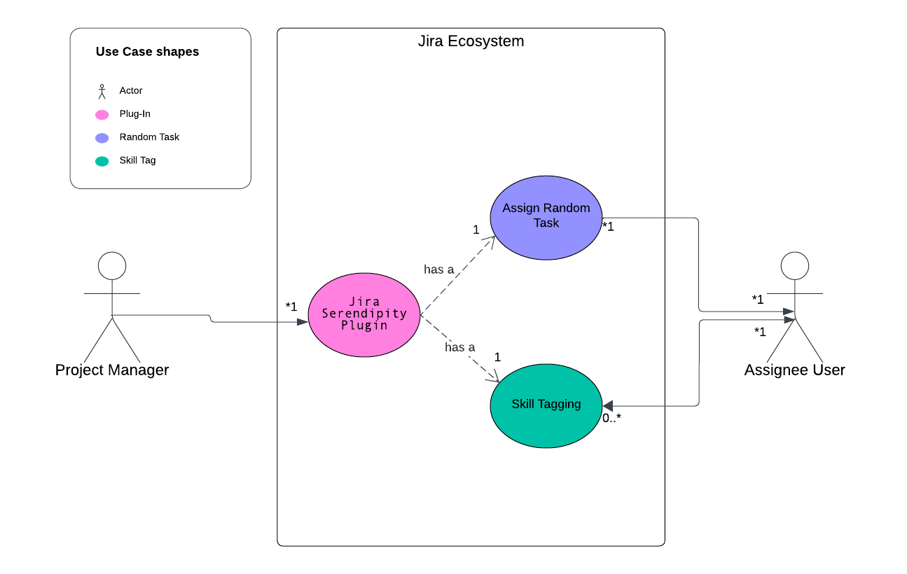
Use-Case Diagram

Slide 15
Wireframe

Slide 16
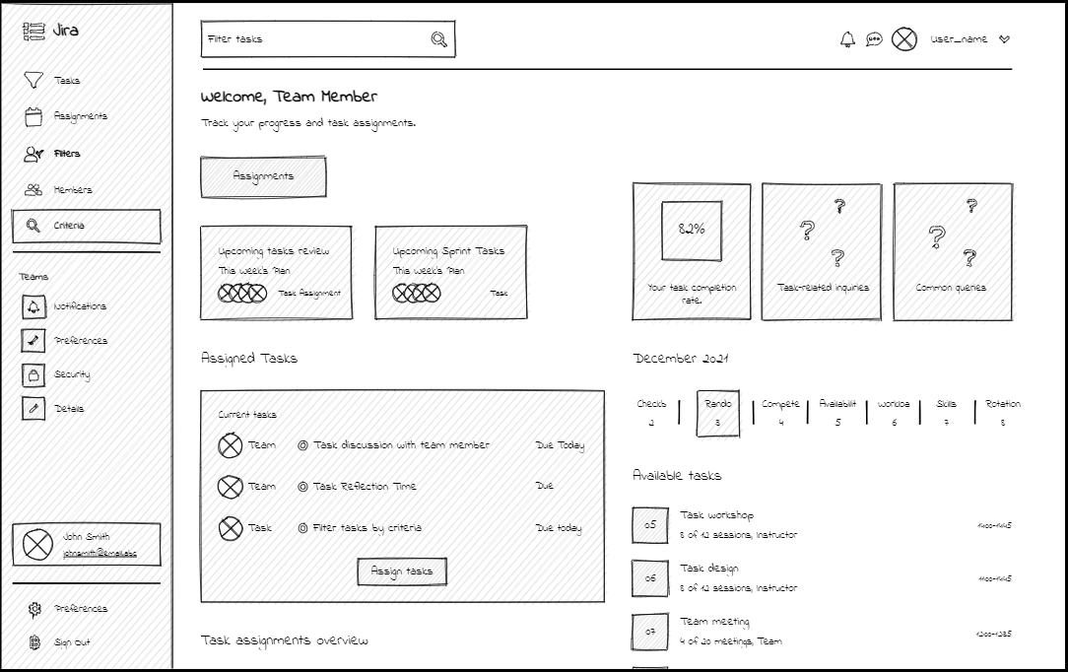
Dash-Board Wireframe

Slide 17
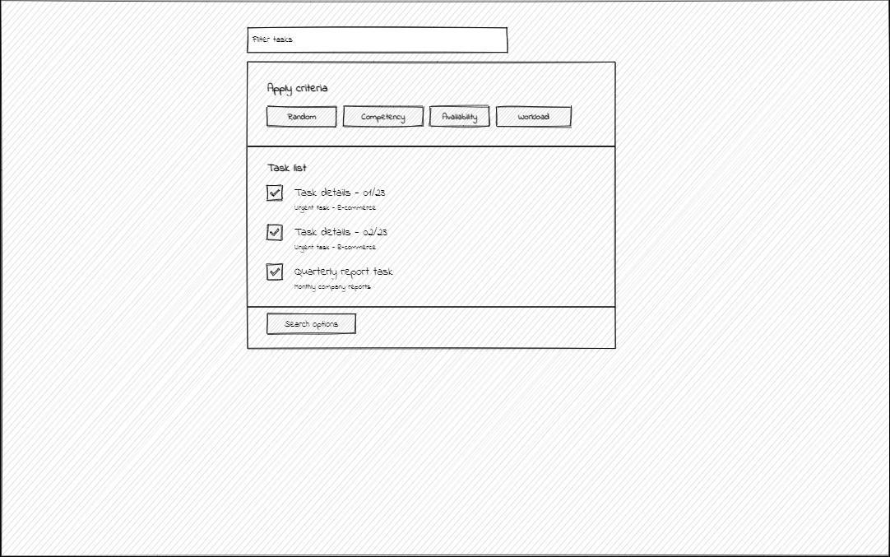
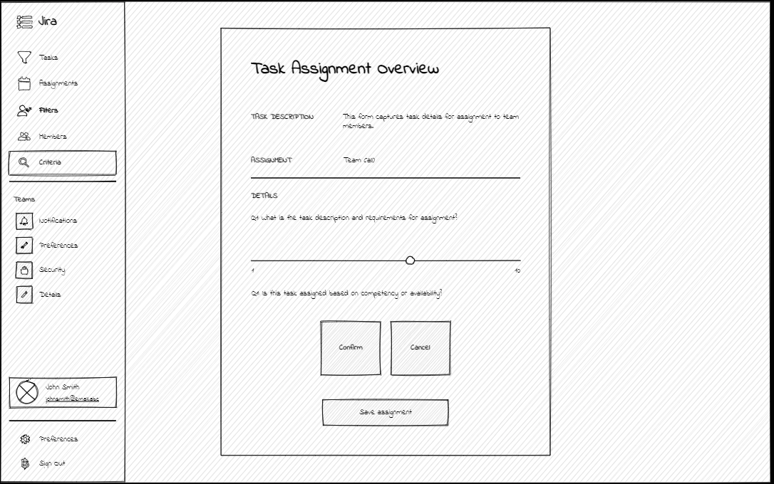
Task Assignment Dashboard

Slide 18
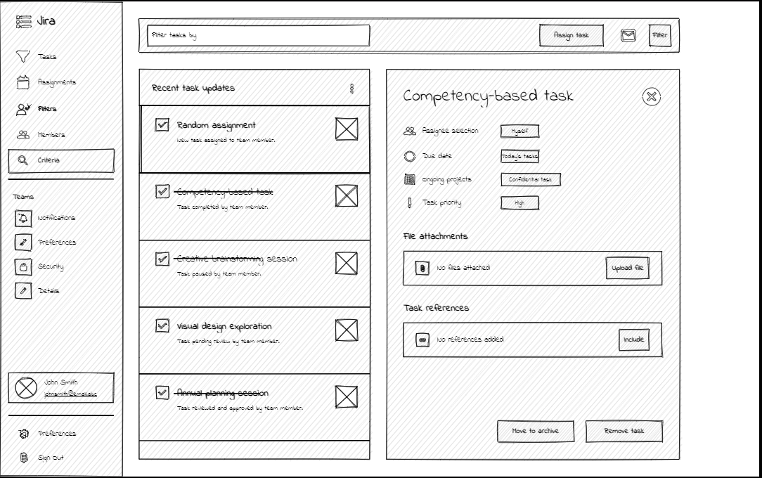
Configuration Settings & Feedback Mechanism(Competency-based tasks) Wireframe

Slide 19
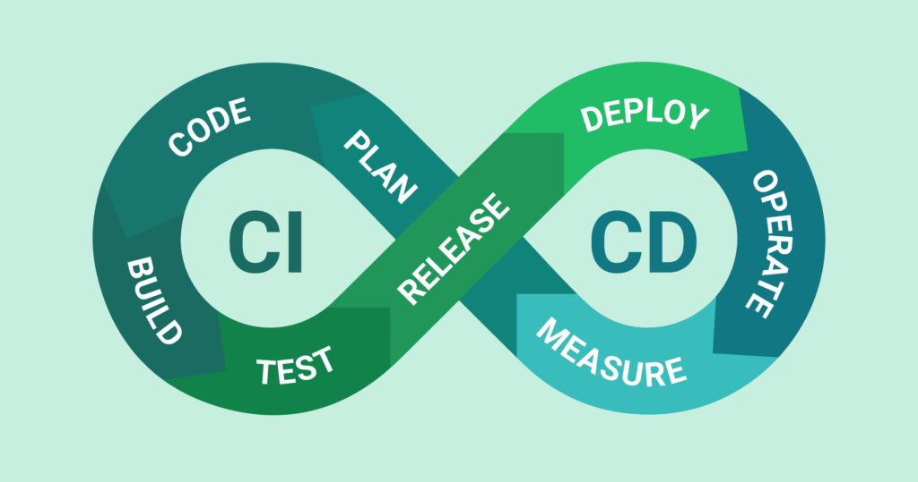
Development Pipeline Design Plan

Slide 20
Version Control & Continuous Integration (CI)
• Utilize Git as the version control system.
• Developers work on individual branches for features or fixes.
• Changes merged into the main branch via pull requests.
• Use tags to mark releases and milestones.
• Implement CI with Jenkins.
• Automated build process triggered on each push to the main branch.
• Includes compiling code, running tests, and generating artifacts.
• Ensures immediate validation and integration of changes.

Slide 21

Continuous Deployment (CD) & Monitoring and Alerting
Manage CD pipeline with Docker and Kubernetes.
Artifacts packaged into Docker containers post CI.
Deployment to a staging environment for testing and validation.
Promote approved containers to production for seamless updates.
Utilize Prometheus for metrics collection.
Grafana for visualization of metrics.
Set up alerts for real-time notification of anomalies or issues.
Enables proactive response and resolution to maintain application health.

Slide 22

Testing Pipeline Design Plan

Slide 23
Test Environment Setup and Automation:
Establish dedicated testing environments mirroring production using Docker containers.
Ensure compatibility with CI/CD pipelines for seamless integration.
Integrate testing frameworks with CI for automated execution and scheduling.
Test Types and Strategies:
Implement a combination of unit, integration, and end-to-end testing.
Utilize automated testing frameworks such as JUnit, Selenium, and Jest.
Prioritize test coverage for critical features and functionalities.
Test Data Management and Security:
Establish procedures for managing test data and environments.
Utilize tools for data generation, sanitization, and migration.
Perform regular security assessments and utilize automated scanning tools for code analysis.

Slide 24
Performance, Load, and Regression Testing:
Conduct performance and load testing to assess system scalability and reliability.
Utilize tools like JMeter or Gatling for simulating user traffic and stress testing.
Implement automated regression testing to ensure code changes do not introduce defects.
User Acceptance Testing (UAT) and Reporting:
Collaborate with stakeholders to define acceptance criteria and test scenarios.
Conduct UAT in a controlled environment to validate user requirements.
Generate test reports detailing results and share insights for continuous improvement.

Slide 25
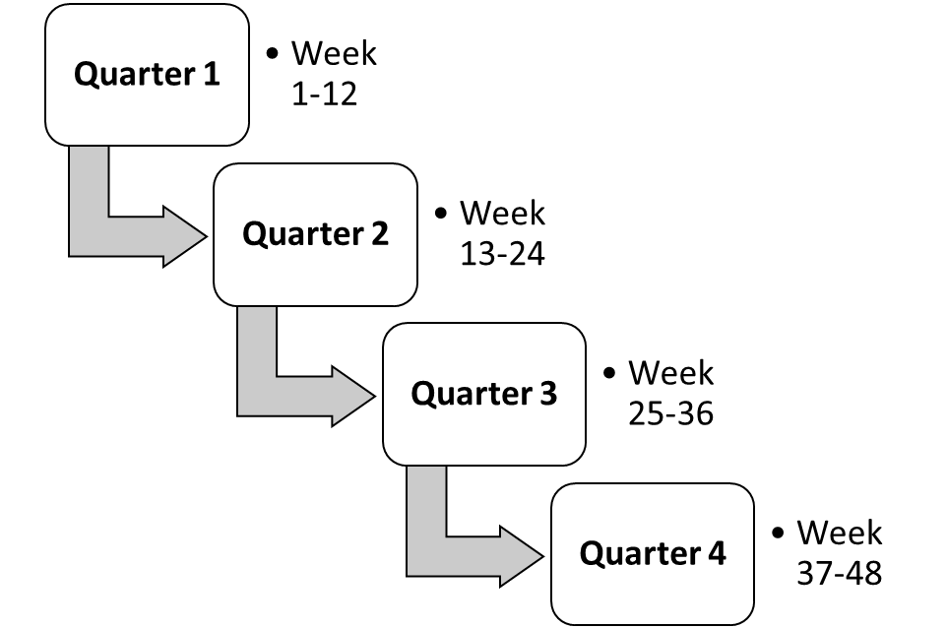
Product Roadmap

Slide 26

Quarter 1: Project Initiation and Foundation(Week 1-3: Project Kickoff & Requirement Gathering, Week 5-8: Architecture Design & Planning, Week 9-12: Development Environment Setup)
Quarter 2: Core Feature Development (Week 13-16: Random Task Assignment, Week 17-20: Competence-Based Assignment Integration, Week 21-24: User Interface Design & Development)
Quarter 3: Testing and Optimization (Week 25-28: Unit and Integration Testing, Week 29-32: User Acceptance Testing, Week 33-36: Performance and Security Testing)
Quarter 4: Release and Deployment(Week 37-40: Staging Deployment & Validation, Week 41-44: Production Deployment, Week 45-48: Post-Release Support & Maintenance)

Slide 27

Product Management Strategies

Slide 28
Pricing Models and Licensing Options:
Tiered Pricing Model: Tailored packages for various customer segments, ensuring flexibility and scalability.
Licensing Options: Offering both perpetual licenses for long-term access and subscription-based models for continuous updates and support.
Go-to-Market Strategies
Targeted Marketing: Highlighting unique value propositions to software teams, project managers, and Jira users.
Partnerships and Integrations: Collaborating with Jira consulting firms and integrating with complementary tools to expand market reach.
Customer Education: Providing tutorials, webinars, and forums for comprehensive understanding and effective utilization.

Slide 29
Feedback Mechanisms
User Feedback Surveys: Regular surveys to gather insights on feature preferences and usability.
In-App Feedback: Real-time feedback within the plugin interface for immediate input.
User Forums: Online communities for idea sharing and collaboration, offering valuable insights into user preferences.
Customer Support, Training, and Documentation
Support Channels: Email, chat, and dedicated portals for prompt assistance.
Training Programs: Comprehensive onboarding and live sessions for user proficiency.
Documentation: Extensive guides and FAQs for self-help, regularly updated to address user needs.

Slide 30

References
1. marketplace.atlassian.com
2. chat.openai.com
3. uizard.io
4. lucid.app
5. Celly, B. (2023). Software Engineering (PowerPoint slides). CSC 581: Software Engineering, Department of Computer Science, California State University, Dominguez Hills.

Slide 31
Thank You!!

